Slide 1
MDU Consolidated Casestudy

Slide 2






Largest medical defence organization (MDO) in the United Kingdom offering indemnity for clinical negligence claims
Online Quotes
Business Challenges/ Needs
Service/Solution Offered
Current system struggles to respond to customer inquiries quickly and efficiently, leading to lost business opportunities and decreased customer satisfaction.
Creating quotes for clients takes a lot of time and work, which is getting more difficult to maintain.
Expanding customer base is making the quote generation process more resource-intensive.
Changepond implemented an online quotes management system to streamline the quote generation process
Integration with the MDU & DDU’s existing website, allowing customers to generate quotes online without the need for human intervention
Technology
Quick and easy quotes attract new customers
Faster response times improve retention
Focus shifts to high-value tasks like sales and support
Key Highlights/Stats

Slide 3
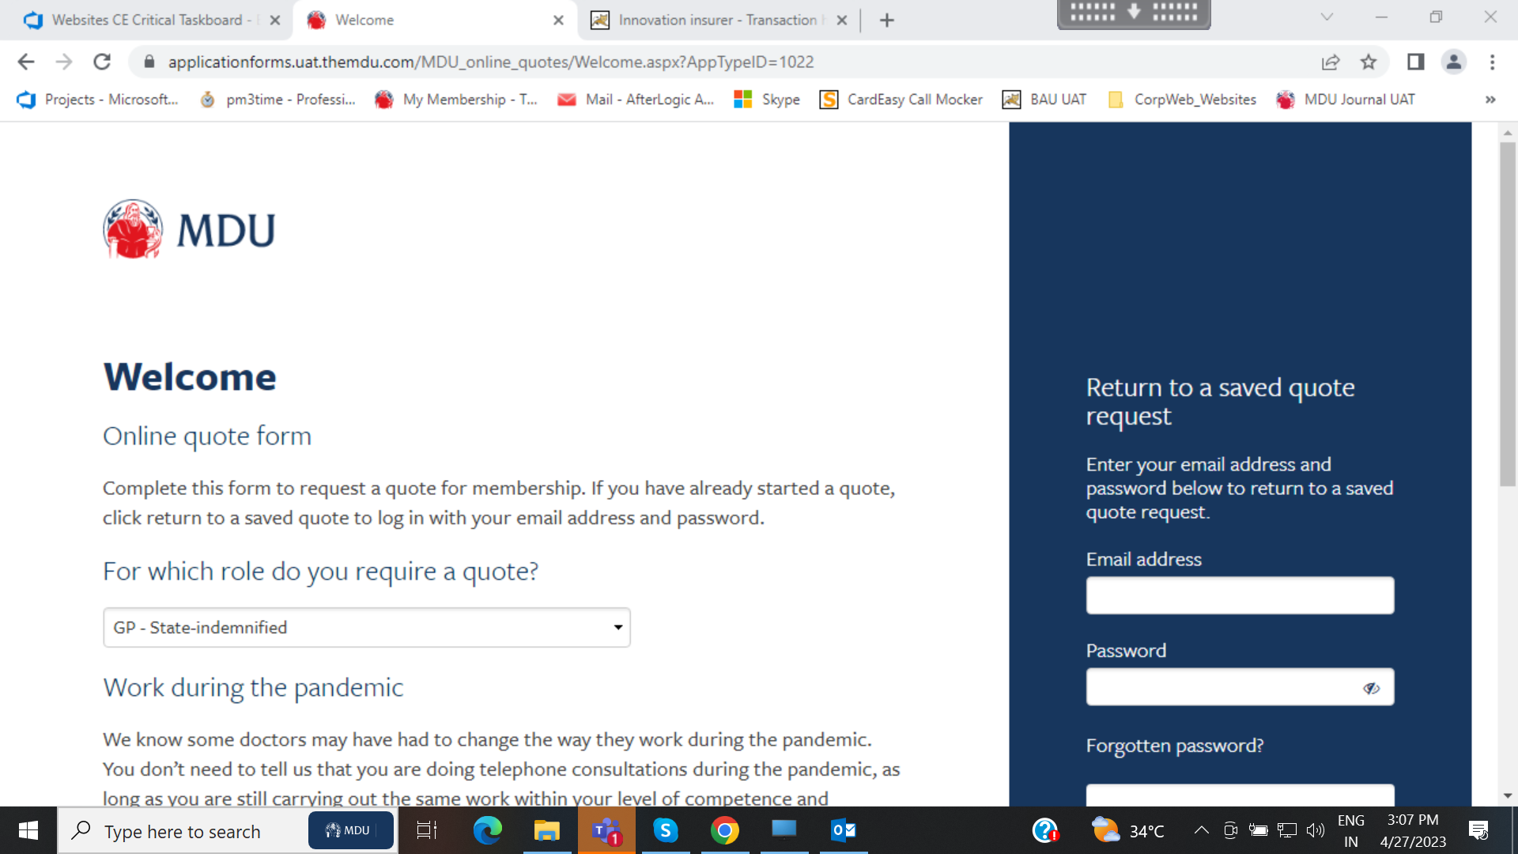
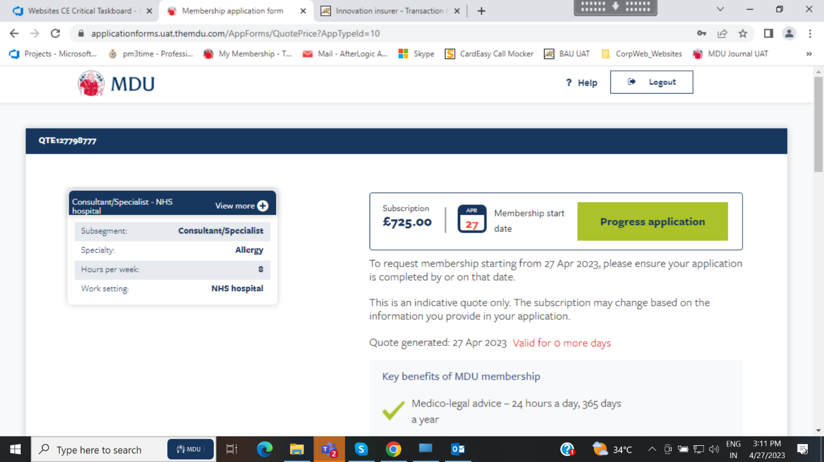
Screenshots

Slide 4
Largest medical defence organization (MDO) in the United Kingdom offering indemnity for clinical negligence claims
Online App Forms
Business Challenges/ Needs
Service/Solution Offered
Time-consuming paper-based process for applying for membership
Delayed processing times and potential loss of business opportunities
Changepond implemented an online application form system to simplify and streamline the membership application process
Integration with the MDU & DDU’s existing website, allowing applicants to complete the form online without the need for a paper-based process
User-friendly and intuitive system design with clear instructions and prompts to guide applicants through the process
Technology
More focus on member support and legal advice.
Faster processing increases customer retention
Lower costs due to reduced paper-based processing
Key Highlights/Stats

Slide 5
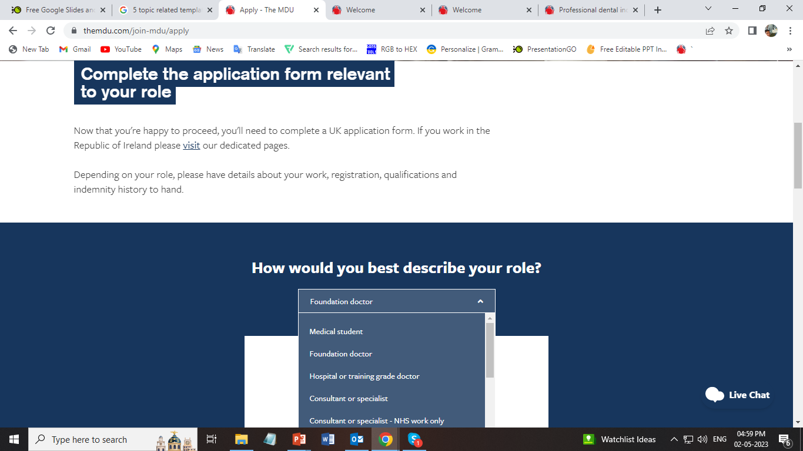
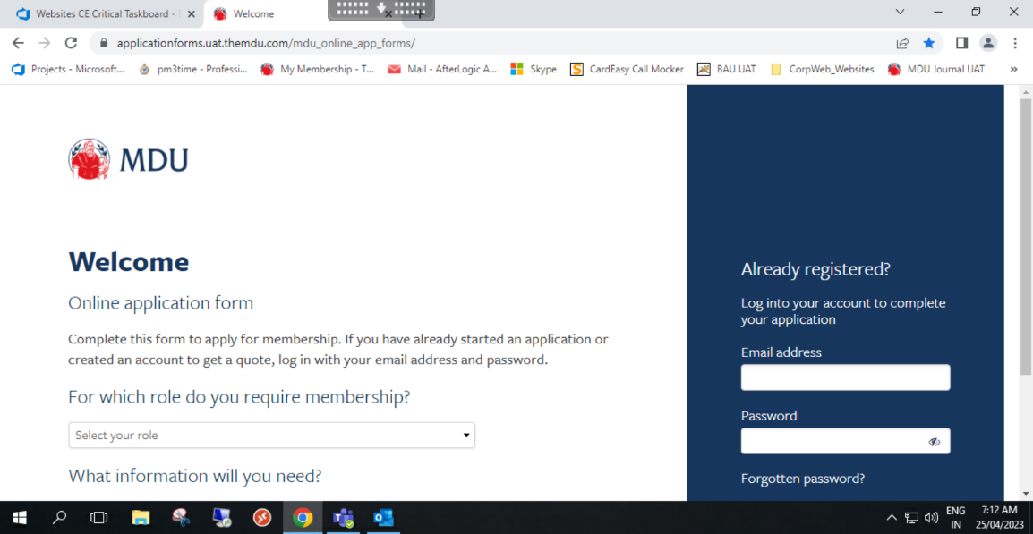
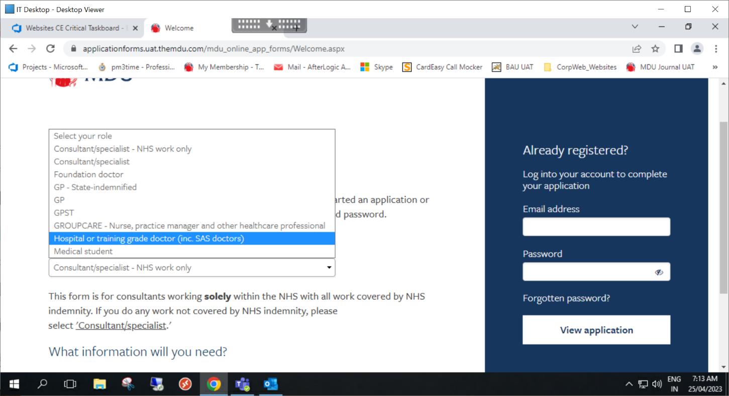
Screenshots

Slide 6
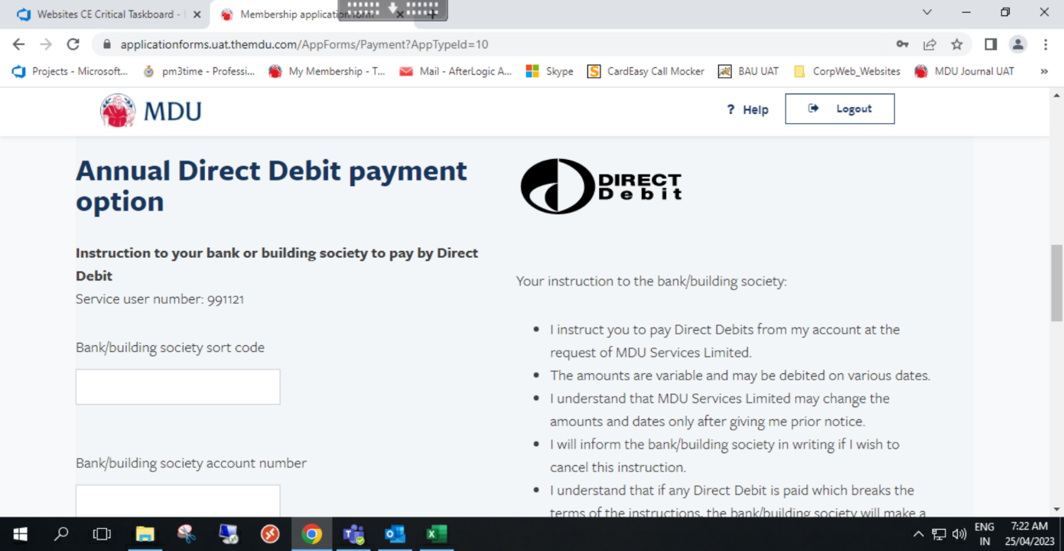
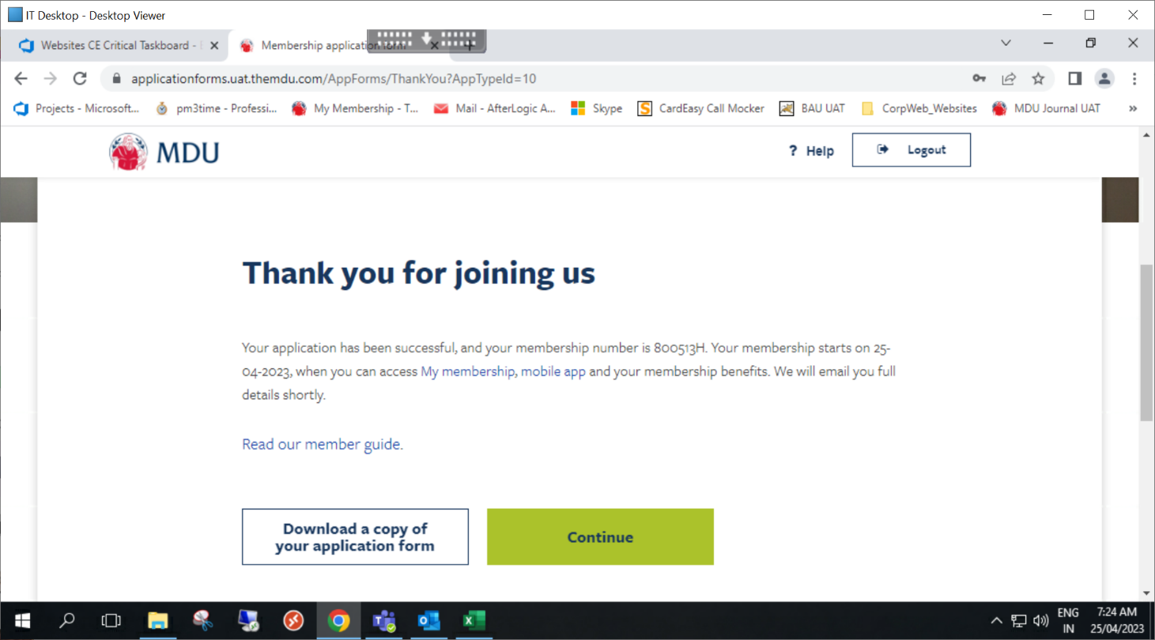
Screenshots

Slide 7
Largest medical defence organization (MDO) in the United Kingdom offering indemnity for clinical negligence claims
Membership Checker
Business Challenges/ Needs
Service/Solution Offered
Manual and time-consuming verification process of membership status.
Potential delays in providing necessary information to members
Changepond has implemented an online individual membership checker, aiming to simplify and streamline the verification process for membership status.
Functionality has been introduced to the MDU & DDU's existing website, enhancing accessibility for both members and non-members.
Real-time verification of membership status is facilitated through integration with the organization's membership database.
Technology
Automated membership verification process
Costs are reduced due to decreased manual processing
Delivering necessary information to members faster
Key Highlights/Stats

Slide 8
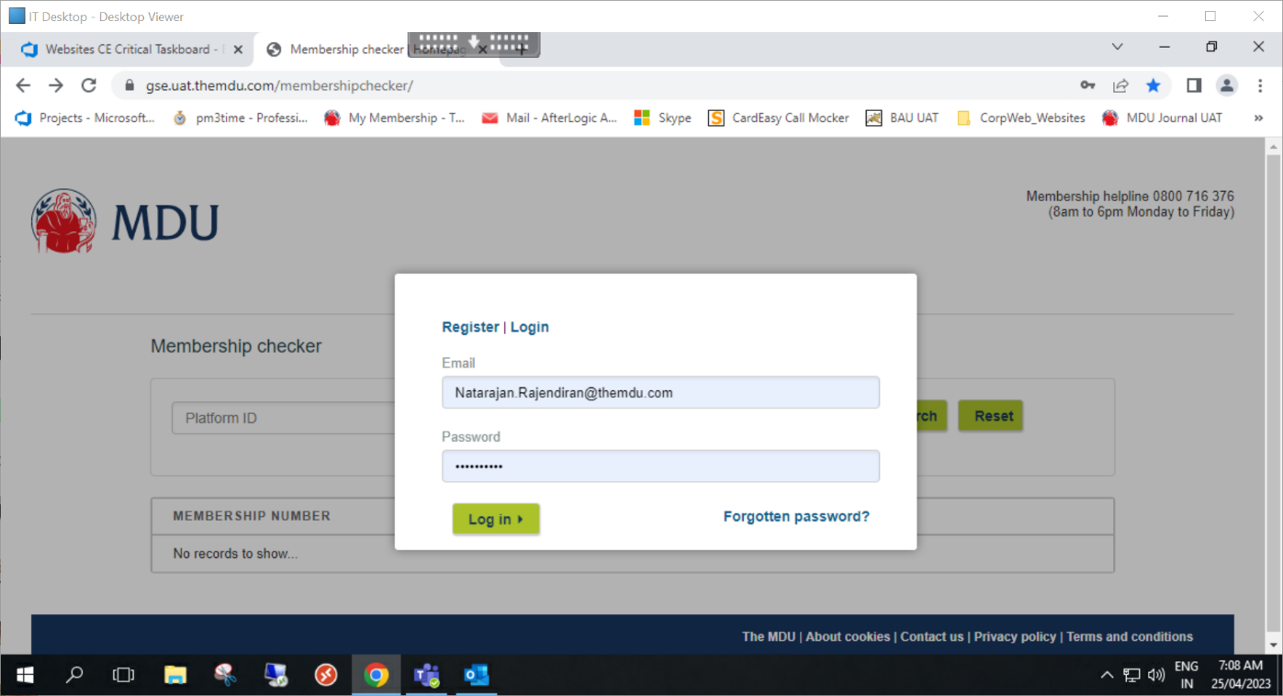
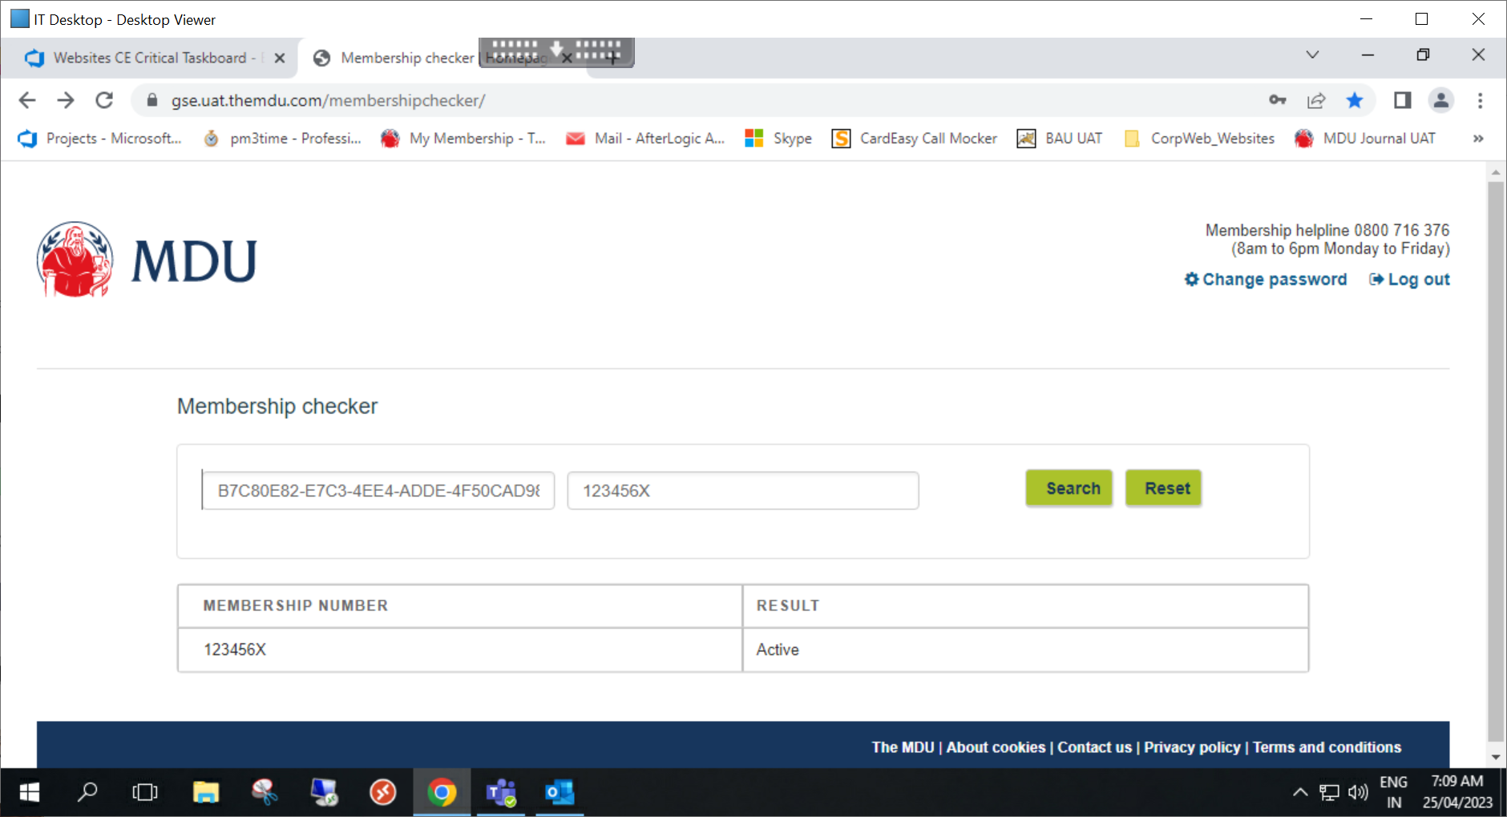
Screenshots

Slide 9
Largest medical defence organization (MDO) in the United Kingdom offering indemnity for clinical negligence claims
Group Enquiry
Business Challenges/ Needs
Service/Solution Offered
Managing enquiries from groups of healthcare professionals is currently manual and time-consuming.
Delays in responding to these enquiries may result in missed business opportunities
Lack of transparency in the enquiry process
Changepond implemented of a Group Enquiry Scheme via a dedicated online portal
Accessibility through integration with the MDU and DDU's current webpage
Integration with the organization's inquiry management system for timely tracking of the status of inquiries and quick response
Technology
Automated
Enquiry process
Faster processing increases customer retention
Focus on member support
Key Highlights/Stats

Slide 10
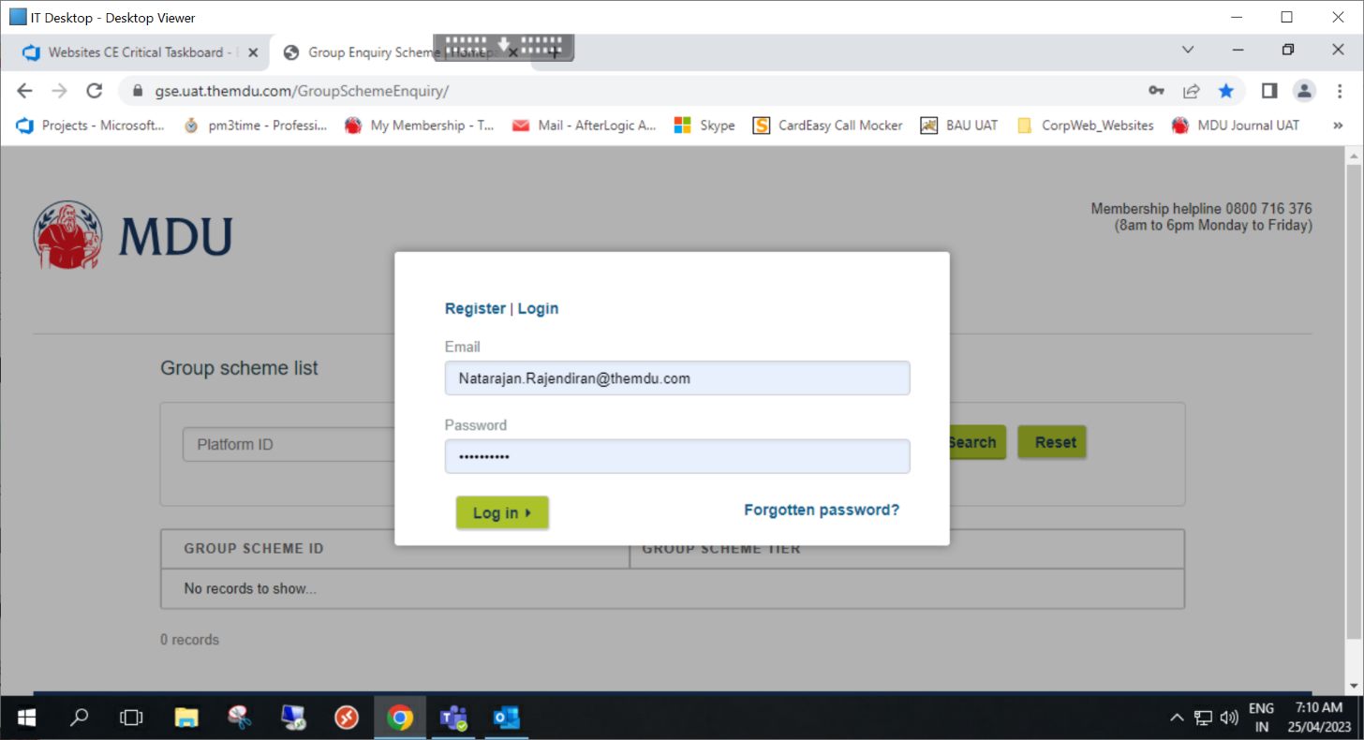
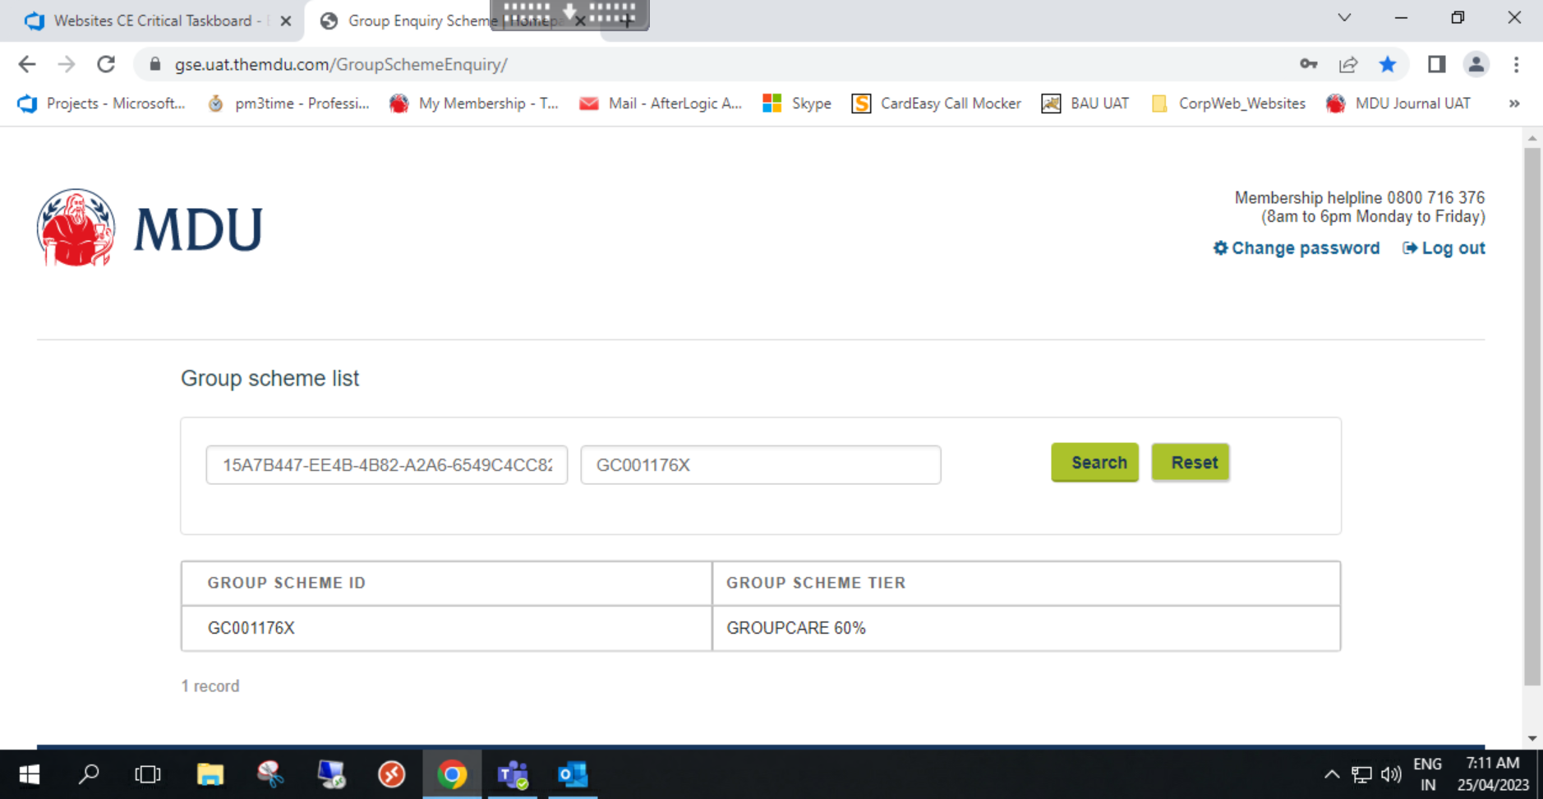
Screenshots

Slide 11
Largest medical defence organization (MDO) in the United Kingdom offering indemnity for clinical negligence claims
My Membership
Business Challenges/ Needs
Service/Solution Offered
Updating member personal profiles manually takes a lot of time including payments
Delays and possible mistakes in member data make it hard to offer timely and effective support.
Changepond created an independent online portal and added a "My Membership" function.
Using My Membership portal, members can update their work details themselves and even they can pay their premium on their own.
For instantaneous modifications to member data, integration with the organization's membership database is required.
Technology
Better member data leads to support and communication.
More focus on
member support
and legal advice.
Efficient personal profile management
Key Highlights/Stats

Slide 12
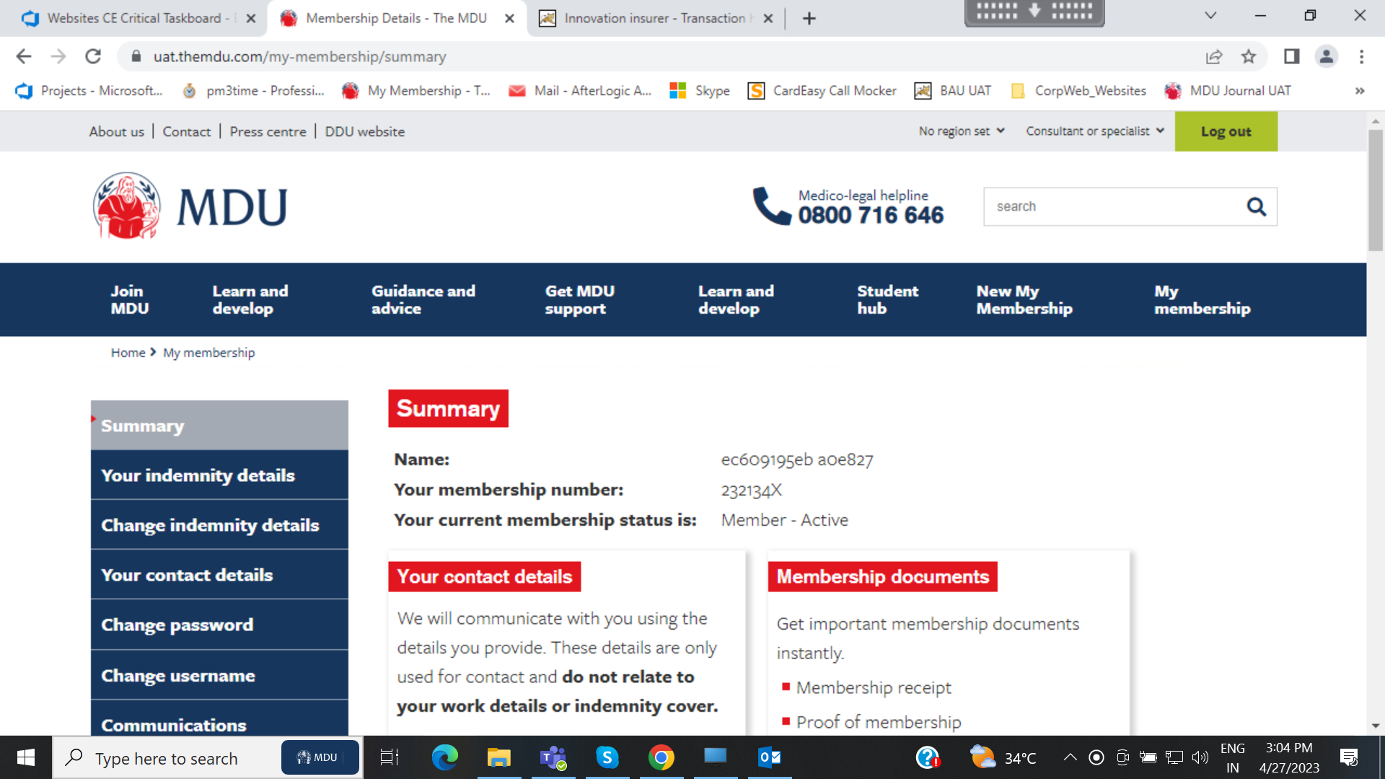
Screenshots

Slide 13





Largest medical defence organization (MDO) in the United Kingdom offering indemnity for clinical negligence claims
Sitecore Upgrade
Business Challenges/ Needs
Service/Solution Offered
MDU lacks the advanced features and enhanced marketing capabilities available in newer versions of Sitecore due to the end of support.
Outdated software can cause slower website loading times and degrade the user experience due to inefficiencies and bloat.
Finding developers proficient in older versions of Sitecore is difficult and expensive, and maintaining an unsupported version is time-consuming and resource-intensive.
Changepond's implementation of Sitecore 9.2 for MDU ensures continuous security updates, protecting against cyber threats and aiding compliance with industry regulations.
Optimization measures result in faster loading times, smoother browsing, and reduced maintenance overheads, alongside improved access to skilled developers, leading to long-term cost savings.
Technology
Simplified Development
Reduced
Maintenance
Faster Loading
& Better Features
Key Highlights/Stats

Slide 14
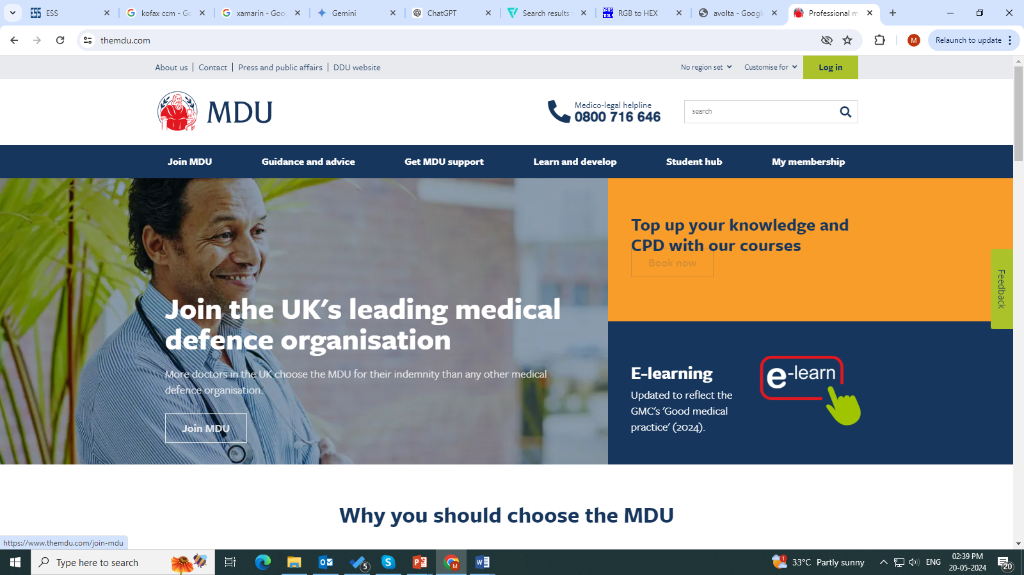
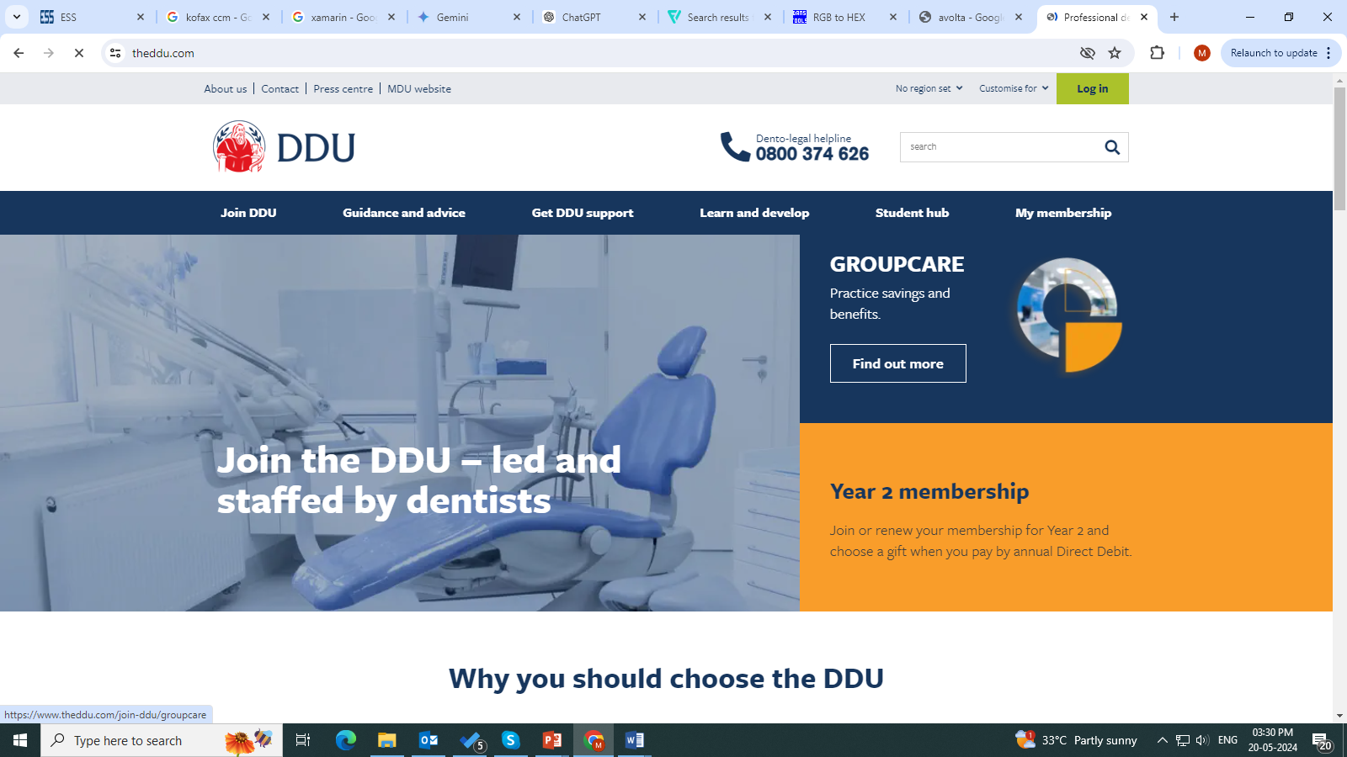
Screenshots

